Slide 1

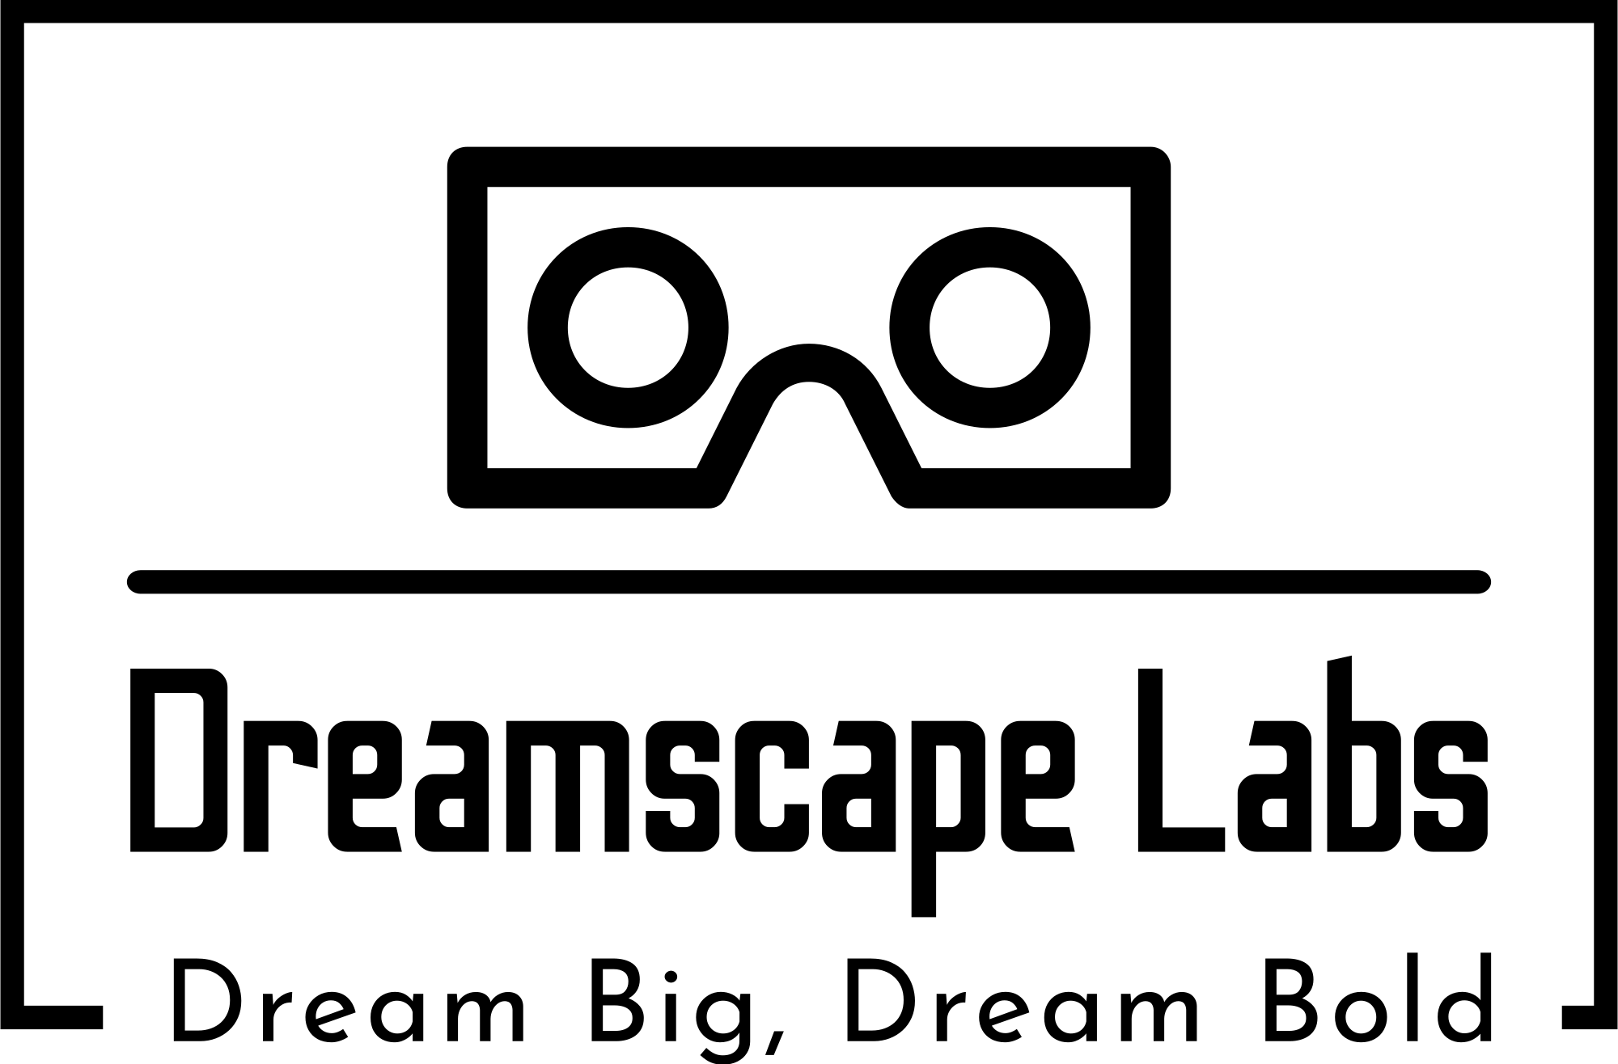

Slide 2
Dreamscape Labs
Dream Big, Dream Bold
Dreamspace Labs is a trailblazer in creating immersive virtual and augmented reality experiences, unlocking new dimensions in human interaction with digital content and the world around us.

Slide 3

Vision
To be a global leader in creating extraordinary virtual and augmented reality experiences that transcend imagination, enriching lives, and reshaping the future of human interaction.
Transforming digital interactions into extraordinary and impactful experiences.
Setting the standard for innovation in VR and AR technology.

Slide 4
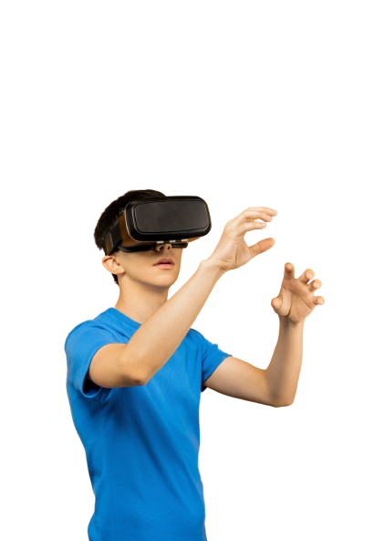
Objectives
Mission: Empowering individuals and businesses through immersive and innovative VR and AR solutions that redefine possibilities and elevate human experiences.
Develop cutting-edge VR/AR products that cater to diverse applications, from entertainment and education to healthcare and beyond.
Deliver unparalleled user experiences by blending technology with creativity, ensuring our solutions captivate and engage users on a profound level.
Foster a culture of continuous innovation within our teams, encouraging exploration of new technologies and pushing the boundaries of VR/AR possibilities.

Slide 5
Organizational Structure
Simple Structure
Being a small company, we embrace a simple and streamlined organizational structure, designed to foster innovation, clarity, and efficient decision-making.
The Simple Structure is characterized by a clear hierarchy and minimal layers of management, facilitating a straightforward flow of communication and decision-making.
This structure allows for quick responses to market changes and ensures a focus on our core competencies in VR and AR innovation.

Slide 6
Team Structure
1. VR / AR Developement team: Creates Quality and immersive experience with up to date technology.
2. Quality Assurance team: Ensuring the highest standards of virtual and augmented reality.
3. Marketing and Sales team: Promoting VR / AR solutions and client engagement.
4. Research and Development team: Exploring emerging technologies and pushing the boundaries of VR/AR.

Slide 7

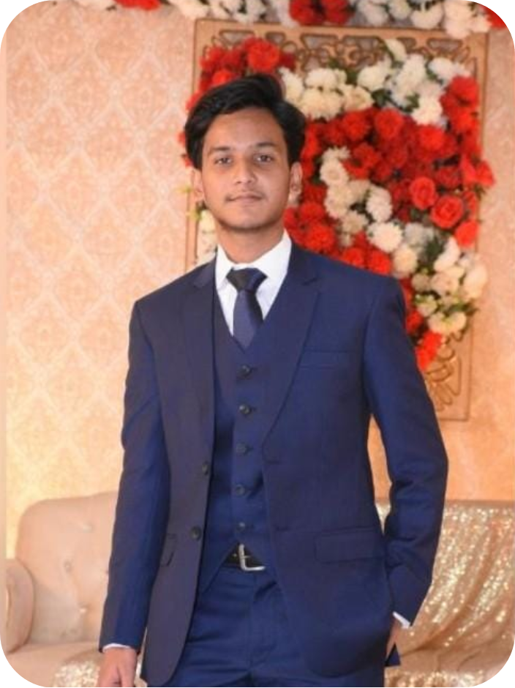

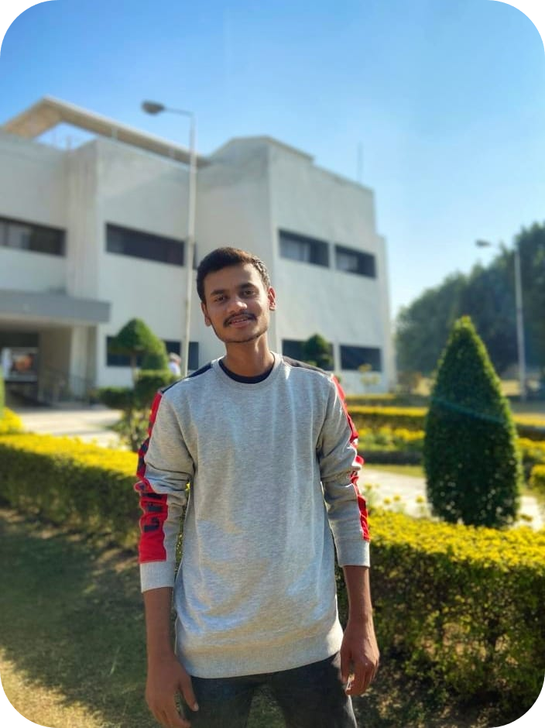
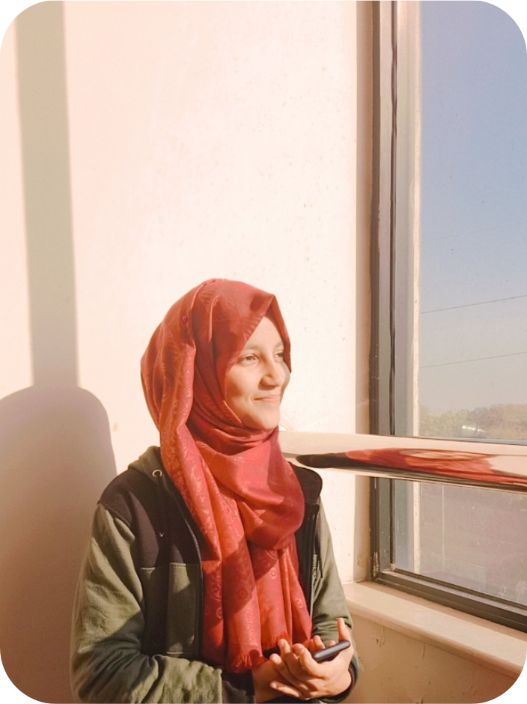
Management Team
Guiding Visionaries Behind Dreamscape
Muzammil
CFO
Baseerat
CMO
Aiza
CLO
Muhammad
CEO
Ali
CTO

Slide 8
Training Plan
Nurturing Excellence Through Continuous Learning
Our training initiatives encompass a range of programs tailored to enhance skills, encourage innovation, and ensure that our teams are equipped to deliver cutting-edge solutions.
1. Technology Workshops: Regular workshops on the latest VR / AR technologies and development tools.
2. Cross-disciplinary Training: Programs to encourage a holistic understanding of the VR/AR landscape, fostering collaboration between different teams.
3. Industry Trends Updates: Continuous updates on industry trends, ensuring that our teams stay informed about the latest advancements.

Slide 9
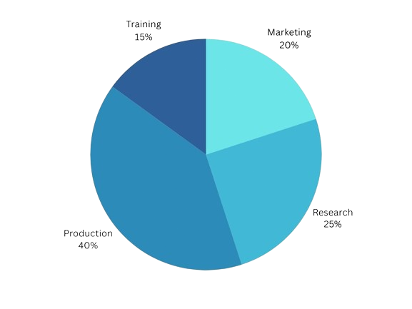
Financial Plan
Charting a Sustainable Path for Growth
The financial backbone of Dreamscape Labs is strategically crafted to ensure sustainability, innovation, and growth. Our financial plan encompasses a well-balanced allocation of resources to drive technological advancements and market presence.
1. Initial Investment: A strategic investment of $30k distributed across research, development, and marketing initiatives.
2. Revenue Streams: Diverse revenue streams, including licensing VR/AR experiences, forming partnerships with businesses, and offering consulting services.
3. Projected Profit Margin: A projected profit margin of 30% by Year 3, indicating the sustainability and growth potential of Dreamscape Labs.

Slide 10
Marketing Plan
Paving the Way for Innovation through Strategic Promotion
Our training initiatives encompass a range of programs tailored to enhance skills, encourage innovation, and ensure that our teams are equipped to deliver cutting-edge solutions.
1. Target Audience: Businesses seeking unique VR/AR solutions, the entertainment industry, and educational institutions.
2. Channels: Online marketing through our website and social media platforms, participation in VR/AR conferences and industry events and strategic partnerships with content creators and influencers.
3. Key Messages: Innovation, immersion, and transformative experiences.

Slide 11
Expansion Plan
Pioneering Global Reach for Immersive Experiences
Dreamscape Labs is poised for strategic expansion to bring our immersive VR and AR experiences to a global audience. Our expansion plan outlines a phased approach to conquer new markets and adapt our innovations to diverse cultures and preferences.
1. Market Research: Conduct thorough market research to understand local preferences and demand.
2. Local Partnerships: Form strategic partnerships with local businesses to enhance market penetration.
3. Adaptation to Regional Preferences: Customize VR and AR experiences to align with regional preferences and cultural nuances.

Slide 12
Thank You for Joining the Vision
Thank you for taking this journey into the immersive world of EnvisioSphere Technologies. Together, we are shaping tomorrow's realities by pushing the boundaries of what's possible in virtual and augmented reality.
As we conclude, Dreamscape Labs is not just a company; it's a community of visionaries, and we look forward to shaping the future of immersive experiences together.

